Slide 1
Hibernate Lifecycle Of Objects
Object having 3 states
Transient state
Persistent state
Detached state

Slide 2
Lifecycle Of Objects
Transient: A new instance of a persistent class which is not associated with a Session and has no representation in the database and no identifier value is considered transient by Hibernate.
Persistent: You can make a transient instance persistent by associating it with a Session. A persistent instance has a representation in the database, an identifier value and is associated with a Session.
Detached: Once we close the Hibernate Session, the persistent instance will become a detached instance.

Slide 3
Lifecycle Of Objects
Transient ,Persistent and Detached states:
When ever an object of a pojo class is created then it will be in the Transient state.
When the object is in a Transient state it doesn’t represent any row of the database, i mean not associated with any Session object, no relation with the database its just an normal object
If we modify the data of a pojo class object, when it is in transient state then it doesn’t effect on the database table
When the object is in persistent state, then it represent one row of the database, if the object is in persistent state then it is associated with the unique Session.
if we want to move an object from persistent to detached state, we need to do either closing that session or need to clear the cache of the session
Again new value will be add and attached with the new session.
if we want to move an object from persistent state into transient state then we need to delete that object permanently from the database

Slide 5
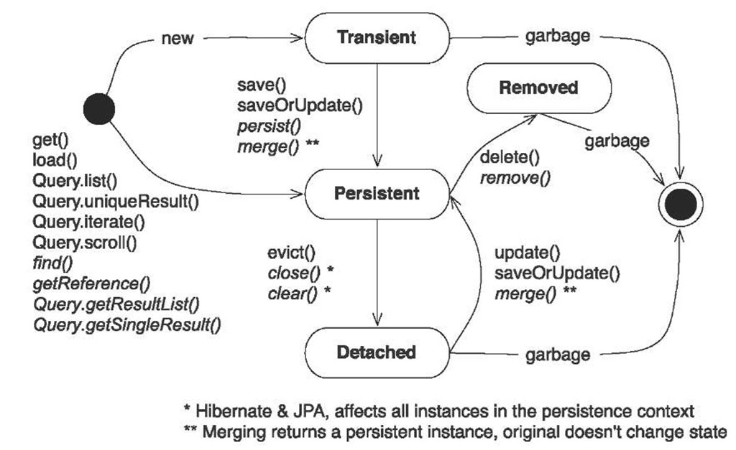
Lifecycle of Objects

Slide 6
S.N. | Session Methods and Description
1 | Transaction beginTransaction() Begin a unit of work and return the associated Transaction object.
2 | void cancelQuery() Cancel the execution of the current query.
3 | void clear() Completely clear the session.
4 | Connection close() End the session by releasing the JDBC connection and cleaning up.
5 | Criteria createCriteria(Class persistentClass) Create a new Criteria instance, for the given entity class, or a superclass of an entity class.
6 | Criteria createCriteria(String entityName) Create a new Criteria instance, for the given entity name.
7 | Serializable getIdentifier(Object object) Return the identifier value of the given entity as associated with this session.
8 | Query createFilter(Object collection, String queryString) Create a new instance of Query for the given collection and filter string.
9 | Query createQuery(String queryString) Create a new instance of Query for the given HQL query string.
10 | SQLQuery createSQLQuery(String queryString) Create a new instance of SQLQuery for the given SQL query string.
11 | void delete(Object object) Remove a persistent instance from the datastore.
12 | void delete(String entityName, Object object) Remove a persistent instance from the datastore.
13 | Session get(String entityName, Serializable id) Return the persistent instance of the given named entity with the given identifier, or null if there is no such persistent instance.
14 | SessionFactory getSessionFactory() Get the session factory which created this session.
15 | void refresh(Object object) Re-read the state of the given instance from the underlying database.
16 | Transaction getTransaction() Get the Transaction instance associated with this session.
17 | boolean isConnected() Check if the session is currently connected.
18 | boolean isDirty() Does this session contain any changes which must be synchronized with the database?
19 | boolean isOpen() Check if the session is still open.
20 | Serializable save(Object object) Persist the given transient instance, first assigning a generated identifier.
21 | void saveOrUpdate(Object object) Either save(Object) or update(Object) the given instance.
22 | void update(Object object) Update the persistent instance with the identifier of the given detached instance.
23 | void update(String entityName, Object object) Update the persistent instance with the identifier of the given detached instance.

Slide 7
Session Factory
org.hibernate.SessionFactory
What is a SessionFactory?
SessionFactory is an interface and extends Referenceable, Serializable
SessionFactory is created using config settings in hibernate.cfg.xml
Should only create one Session Factory per database
Can create another one when connecting to an external database
Usually application has single SessionFactory
It is Thread Safe
It is immutable
Only one instance is created
Optionally holds second-level cache

Slide 8
org.hibernate.Session
A single-threaded, short-lived object representing a conversation between the application and the persistent store.
Wraps a JDBC connection.
Factory for Transaction.
Holds a mandatory (first-level) cache of persistent objects, used when navigating the object graph or looking up objects by identifier.

Slide 9
org.hibernate.Session
createQuery – SELECT statement
save() – INSERT Statement
update() – UPDATE Statement
saveOrUpdate() , saveOrUpdateall()
delete() - DELETE Statement
beginTransaction() – Returns transaction object
createSQLQuery() – Create DB native sql query
load(dto.class, pk) - Loads record
Throws exception if record does not exist
get(dto.class, pk) - Get a record
Return null in case record does not exist

Slide 10
Cache
Every fresh session having its own cache memory.
Caching is a mechanism for storing the loaded objects into a cache memory.
The advantage of cache mechanism is, whenever again and again we want to load the same object from the database then instead of hitting the database once again, it loads from the local cache memory only.
so that the no. of round trips between an application and a database server got decreased.
It means caching mechanism increases the performance of the application.
In hibernate we have two levels of caching
First Level Cache [ or ] Session Cache
Second Level Cache [ or ] Session Factory Cache

Slide 11
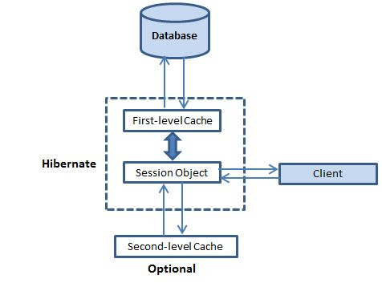
Cache
Caching is all about application performance optimization and it sits between your application and the database to avoid the number of database hits as many as possible to give a better performance for performance critical applications.

Slide 12
First-level cache:
The first-level cache is the Session cache and is a mandatory ( DEFAULT )cache through which all requests must pass. The Session object keeps an object under its own power before committing it to the database.
If you issue multiple updates to an object, Hibernate tries to delay doing the update as long as possible to reduce the number of update SQL statements issued. If you close the session, all the objects being cached are lost and either persisted or updated in the database.

Slide 13
Second-level cache:
Second level cache is an Session Factory optional cache and first-level cache will always be consulted before any attempt is made to locate an object in the second-level cache. The second-level cache can be configured on a per-class and per-collection basis and mainly responsible for caching objects across sessions.
Any third-party cache can be used with Hibernate. An org.hibernate.cache.CacheProvider interface is provided, which must be implemented to provide Hibernate with a handle to the cache implementation.

Slide 14
Cache provider:
Your next step after considering the concurrency strategies you will use for your cache candidate classes is to pick a cache provider. Hibernate forces you to choose a single cache provider for the whole application.
S.N. | Cache Name | Description
1 | EHCache | It can cache in memory or on disk and clustered caching and it supports the optional Hibernate query result cache.
2 | OSCache | Supports caching to memory and disk in a single JVM, with a rich set of expiration policies and query cache support.
3 | warmCache | A cluster cache based on JGroups. It uses clustered invalidation but doesn't support the Hibernate query cache
4 | JBoss Cache | A fully transactional replicated clustered cache also based on the JGroups multicast library. It supports replication or invalidation, synchronous or asynchronous communication, and optimistic and pessimistic locking. The Hibernate query cache is supported

Slide 15
To achieve second level cache :
hibernate.cfg.xml
<property name="hibernate.cache.provider_class"> org.hibernate.cache.EhCacheProvider </property>
<prop key="hibernate.cache.use_second_level_cache">
true</prop>

Slide 16
Example for second level cache:
import org.hibernate.Session;
import org.hibernate.SessionFactory;
import org.hibernate.cfg.Configuration;
public class FetchTest {
public static void main(String[] args) {
Configuration cfg=new Configuration().configure("hibernate.cfg.xml");
SessionFactory factory=cfg.buildSessionFactory();
Session session1=factory.openSession();
Employee emp1=(Employee)session1.load(Employee.class,121);
System.out.println(emp1.getId()+" "+emp1.getName()+" "+emp1.getSalary());
session1.close();
Session session2=factory.openSession();
Employee emp2=(Employee)session2.load(Employee.class,121);
System.out.println(emp2.getId()+" "+emp2.getName()+" "+emp2.getSalary());
session2.close();
}
} // Second level cache will always work on the entire application level.
Note :- As we can see here, hibernate does not fire query twice. If you don't use second level cache, hibernate will fire query twice because both query uses different session objects.

Slide 17
Query-level cache:
Hibernate also implements a cache for query resultsets that integrates closely with the second-level cache.
This is an optional feature and requires two additional physical cache regions that hold the cached query results and the timestamps when a table was last updated. This is only useful for queries that are run frequently with the same parameters.

Slide 18
To achieve Query level cache :
hibernate.cfg.xml
<prop key="hibernate.cache.use_query_cache
">true</prop>
On java class:-
Session session = SessionFactory.openSession();
Query query = session.createQuery("FROM EMPLOYEE");
query.setCacheable(true);
List users = query.list(); SessionFactory.closeSession();
A cache region is part of the cache that's given a name.
query.setCacheRegion("employee");

Slide 19
Named Query In hibernate
Hibernate named queries provide a data access and manipulation mechanism that closely ties the query content to the Java code.
Named Query is way to use any query by some meaningful name. It is like using alias name.
A security related advantage to named queries is that dynamic data must be bound, which prevents SQL injection attacks.
It also removes the actual query language from Java code, which is a common tactic and creates certain maintainability issues.

Slide 20
Named Queries
<hibernate-mapping package="com.Aartek.dto">
<class name=“partDTO" table="users">
<id name="id" column="ID">
<generator class="increment" />
</id>
<property name="lastName" column="LAST_NAME" />
<property name="firstName" column="FIRST_NAME" />
<property name="address" column="STREET" />
<property name="userId" column="LOGIN_ID" />
<property name="password" column="PASSWORD" />
</class>
<!-- Named Query -->
<query name="allpart">
<![CDATA[ from partDTO ]]>
</query>
</hibernate-mapping>

Slide 21
Named Query (Contd)
SessionFactory sessionFactory = new Configuration().configure()
.buildSessionFactory();
Session s = sessionFactory.openSession();
Query q = s.getNamedQuery("allpart");
List l = q.list();
Iterator it = l.iterator();

